Slide 1

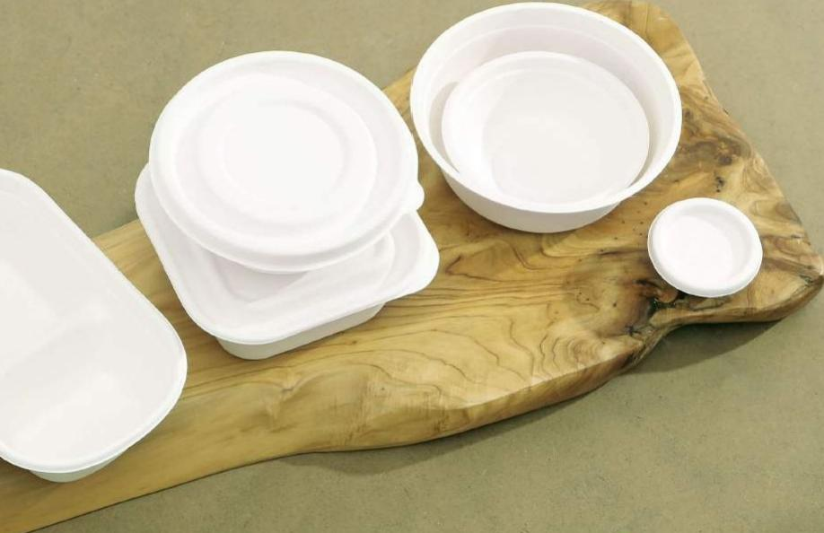

GREEN
PACKAGING

Slide 2

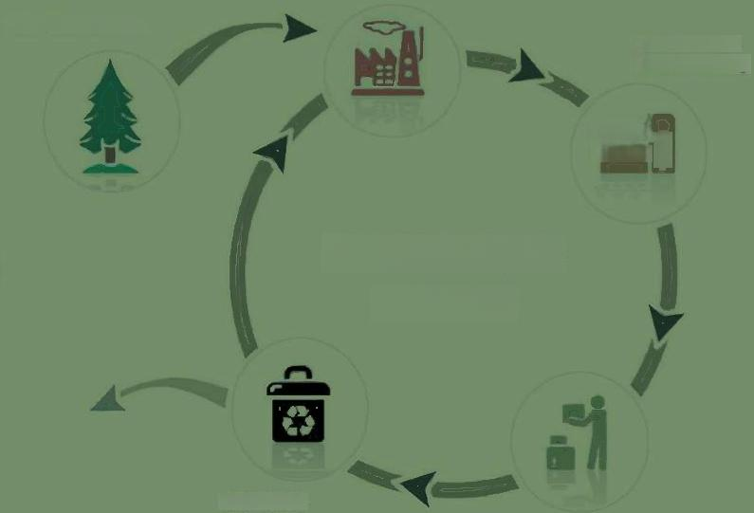
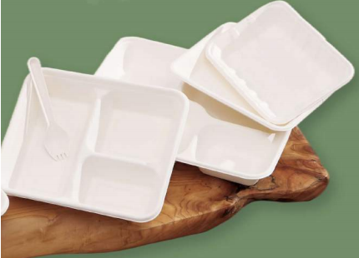
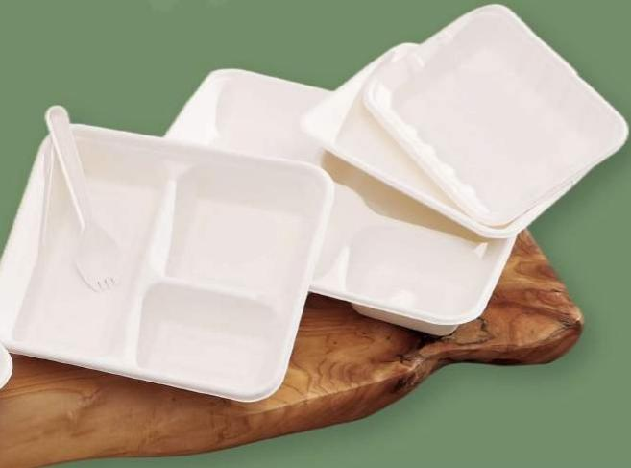
Why SL GLOBAL Packaging?
We are committed to providing our sustainable packaging alternatives as a viable solution to reduce plastic waste and to create a better world.Our belief in achieving sustainability through maintaining cycles is reflected on how we serve our customers.We are passionate about working with professionals across industry sectors to share resources on com- postables and composting solutions.
Pulp and Paper Productlon
Fiber Procurement
FInal Product Manufacturlng
000 g
The Life Cycle
of Paper
End-of-LIte
Flnal Product Uso

Slide 3


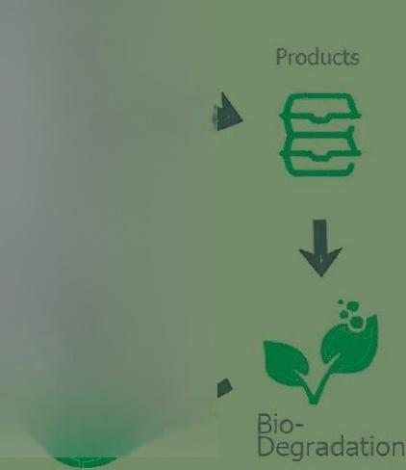

CATALOGUE
SL GLOBAL | 3-4
Bagasse Plate | 5-6
Bagasse Tray | 7-8
Bagasse Bowl | 9-10
Bagasse Clamshell | 11-12
Bagasse Cup | 13-14
Paper Straw | 15
Bagasse Cutlery | 16
Paper Cutlery
Certification&Testing |  | 18
IGreen Experiment | 19
Composting FAQ | 20
Bagasse Pulp
The Life Cycle
of Bagasse
Sugarcane
Compost

Slide 4

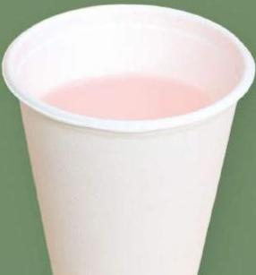
SL Global Partner on Green Packaging
Ban on Single-use foodservice plastics have taken effects in some countries worldwide.For everyone in food packaging business,we understand that your demands to have an SL Global partner and your requirements on green packaging.For those who are out of this field,we believe that you have seen the potentials here and your needs to expand the business range.Therefore,here comes the SL Global Packaging.SL Global who exists for food only provide 100%compostable foodservice and packaging products which is made from advanced renewable resources,require less energy to produce and reduce pollution and waste.
Our mission,vision,and values have always stayed the same —to offer ideal food-packaging solutions for a more sustain- able world.

Slide 5




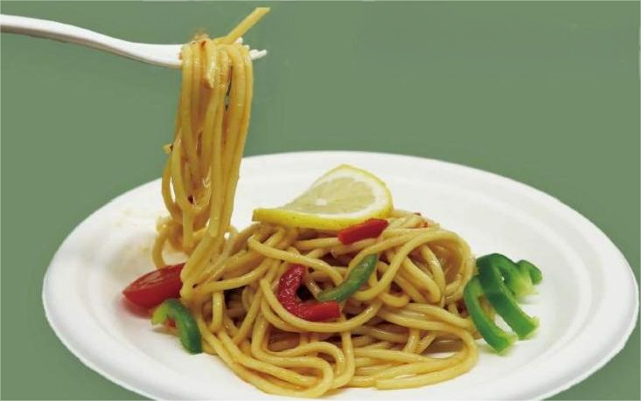

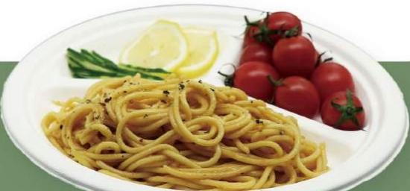
PLATE
·Materical:Made from 100%renewable resources.
·Packing:50PCS/PACK;500PCS/CTN.
·Meet ASTM standards for compostability.
·These plates are appropriate for hot or cold food and usually for restaurants cafes and convenience store.
Item Code:IG-PP
Description:Sugarcane Bagasse Plate
Available Size:6"/7/8.75/9"/10"
Item Code:IG-PP-3C
Description:Sugarcane Bagasse Plate-3 Compartments Available Size:9"/10"
Item Code:IG-PSP
Description:Sugarcane Bagasse Square Plate Available Size:6"/8"/10"
Item Code:IG-POP
Description:Sugarcane Bagasse Plate-Oval Plate Available Size:10”×7.5”12"×10"

Slide 6

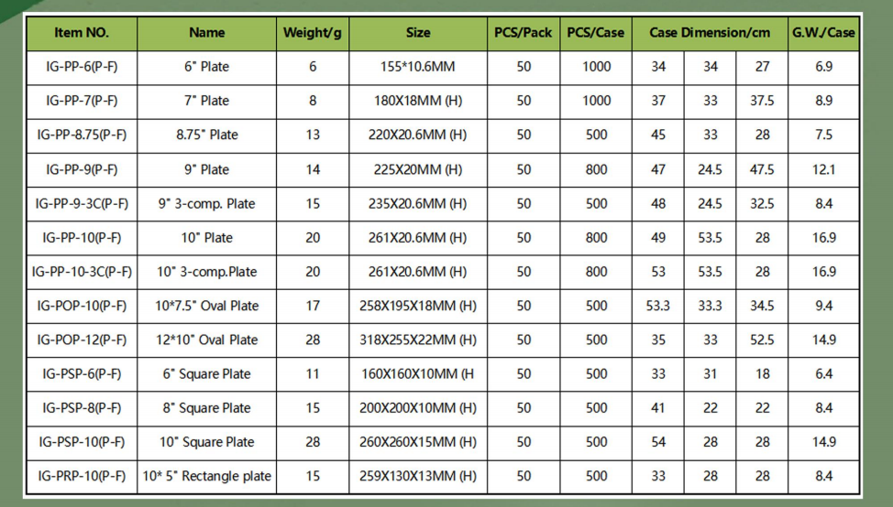
Bagasse Plate
Item NO. | Name | Weight/g | Size | PCS/Pack | PCS/Case | Case Dimension/cm |  |  | G.WJCase
IG-PP-6(P-F) | 6"Plate | 6 | 155*10.6MM | 50 | 1000 | 34 | 34 | 27 | 6.9
IG-PP-7(P-F) | 7”Plate | 8 | 180X18MM(H) | 50 | 1000 | 37 | 33 | 37.5 | 8.9
IG-PP-8.75(P-F) | 8.75"Plate | 13 | 220X20.6MM(H) | 50 | 500 | 45 | 33 | 28 | 7.5
IG-PP-9(P-F) | 9"Plate | 14 | 225X20MM(H) | 50 | 800 | 47 | 24.5 | 47.5 | 12.1
IG-PP-9-3C(P-F) | 9"3-comp.Plate | 15 | 235X20.6MM(H) | 50 | 500 | 48 | 24.5 | 32.5 | 8.4
IG-PP-10(P-) | 10"Plate | 20 | 261X20.6MM(H) | 50 | 800 | 49 | 53.5 | 28 | 16.9
IG-PP-10-3C(P-F) | 10°3-comp.Plate | 20 | 261X20.6MM(H) | 50 | 800 | 53 | 53.5 | 28 | 16.9
IG-POP-10(P-F) | 10*7.5"Oval Plate | 17 | 258X195X18MM(H) | 50 | 500 | 53.3 | 33.3 | 34.5 | 9.4
IG-POP-12(P-F) | 12*10"Oval Plate | 28 | 318X255X22MM(H) | 50 | 500 | 35 | 33 | 52.5 | 14.9
IG-PSP-6(P-F) | 6"Square Plate | 11 | 160X160X10MM(H | 50 | 500 | 33 | 31 | 18 | 6.4
IG-PSP-8(P-) | 8"Square Plate | 15 | 200X200X10MM(H) | 50 | 500 | 41 | 22 | 22 | 8.4
IG-PSP-10(P-F) | 10°Square Plate | 28 | 260X260X15MM(H) | 50 | 500 | 54 | 28 | 28 | 14.9
IG-PRP-10(P-F) | 10*5”Rectangle plate | 15 | 259X130X13MM(H) | 50 | 500 | 33 | 28 | 28 | 8.4

Slide 7

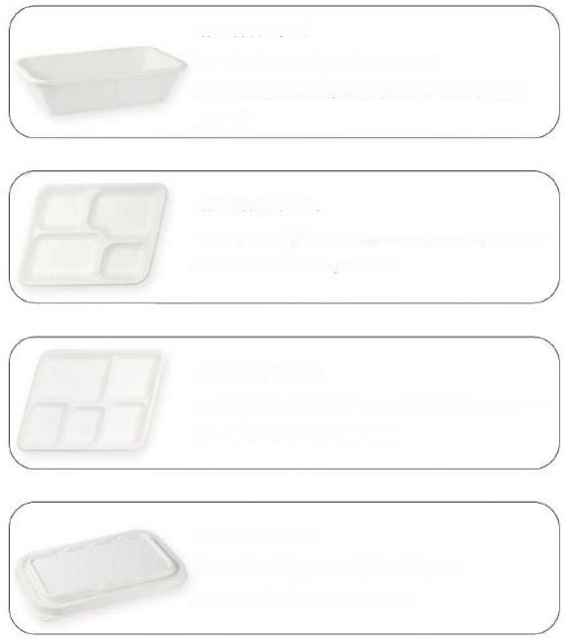
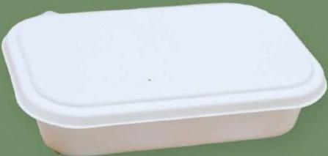
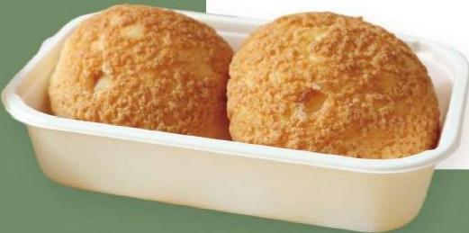
Item Code:IG-PT
Description:Sugarcane Bagasse Tray
Available Size:400ml/500ml/650ml/750ml/950ml
/1000ml
Item Code:IG-PT-C
Description:Sugarcane Bagasse Tray-4 Compartments
Available Size:4 Compartments
Item Code:IG-PT-C
Description:Sugarcane Bagasse Tray-5 Compartments
Available Size:5 Compartments
Item Code:IG-PT-L
Description:Sugarcane Bagasse Tray Lid
Available Size:Fit the above Trays
TRAY
·Materical:Made from 100%renewable resources.
·Packing:50PCS/PACK;500PCS/CTN.
·Meet ASTM standards for compostability.
·iGreen versatile fast food trays are made from recycled paper pulp,an annually renewable resource.
·Fiber serving trays are great for cafeterias,healthcare centers and schools.

Slide 8
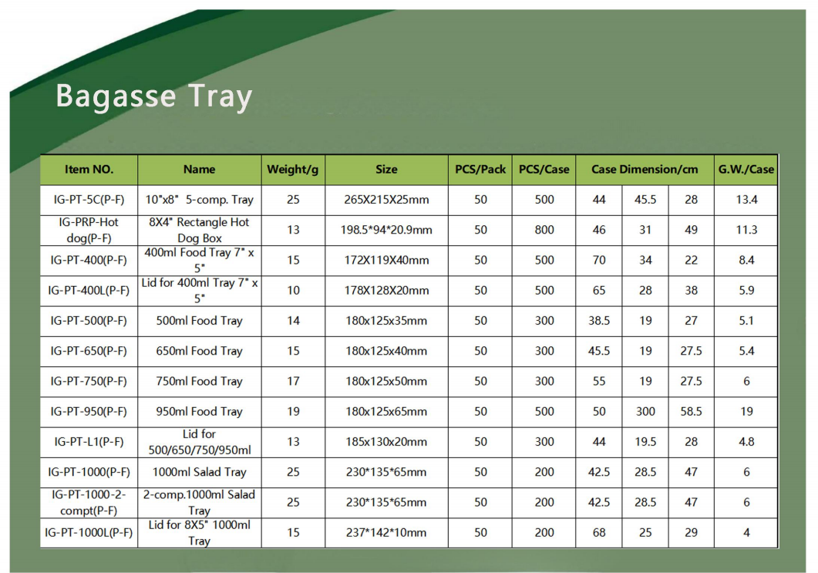
Bagasse Tray
Item NO. | Name | Weight/g | Size | PCS/Pack | PCS/Case | Case Dimension/cm |  |  | G.W./Case
IG-PT-5C(P-F) | 10"x8°5-comp.Tray | 25 | 265X215X25mm | 50 | 500 | 44 | 45.5 | 28 | 13.4
IG-PRP-Hot dog(P-F) | 8X4°Rectangle Hot Dog Box | 13 | 198.5*94*20.9mm | 50 | 800 | 46 | 31 | 49 | 11.3
IG-PT-400(P-F) | 400ml Food Tray 7"x | 15 | 172X119X40mm | 50 | 500 | 70 | 34 | 22 | 8.4
IG-PT-400L(P-F) | Lid for 400ml Tray7"× 5" | 10 | 178X128X20mm | 50 | 500 | 65 | 28 | 38 | 5.9
IG-PT-500(P-F) | 500ml Food Tray | 14 | 180x125x35mm | 50 | 300 | 38.5 | 19 | 27 | 5.1
IG-PT-650(P-F) | 650ml Food Tray | 15 | 180x125x40mm | 50 | 300 | 45.5 | 19 | 27.5 | 5.4
IG-PT-750(P-F) | 750ml Food Tray | 17 | 180x125x50mm | 50 | 300 | 55 | 19 | 27.5 | 6
IG-PT-950(P-F) | 950ml Food Tray | 19 | 180x125x65mm | 50 | 500 | 50 | 300 | 58.5 | 19
IG-PT-L1(P-F) | Lid for 500/650/750/950ml | 13 | 185x130x20mm | 50 | 300 | 44 | 19.5 | 28 | 4.8
IG-PT-1000(P-F) | 1000ml Salad Tray | 25 | 230*135*65mm | 50 | 200 | 42.5 | 28.5 | 47 | 6
IG-PT-1000-2- compt(P-F) | 2-comp.1000ml Salad | 25 | 230*135*65mm | 50 | 200 | 42.5 | 28.5 | 47 | 6
IG-PT-1000L(P-F) | Lid f r×51000ml Tray | 15 | 237*142*10mm | 50 | 200 | 68 | 25 | 29 | 4

Slide 9

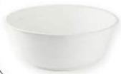

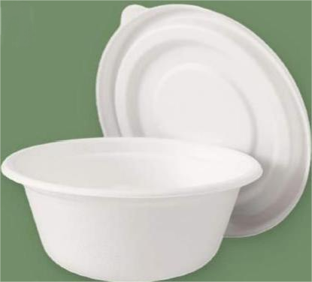
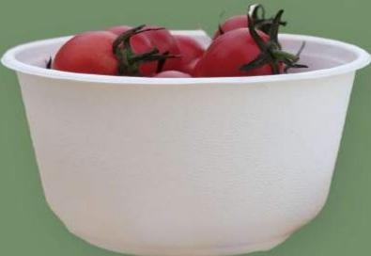
Item Code:IG-PB
Description:Sugarcane Bagasse Bowl
Available Size:350ml/425ml/500ml/850ml/1000ml
Item Code:IG-PB-L
Description:Sugorcane Bagasse Bowl Lid
Available Size:350ml/425ml/500ml/850ml/1000ml
BOWL
·Materical:Made from 100%renewable resources.
·Packing:50PCS/PACK;600PCS/CTN.
·They are durable and soak proof.Great for hot and cold food like soup,salad,fruit,oatmeal,or ice cream.

Slide 10

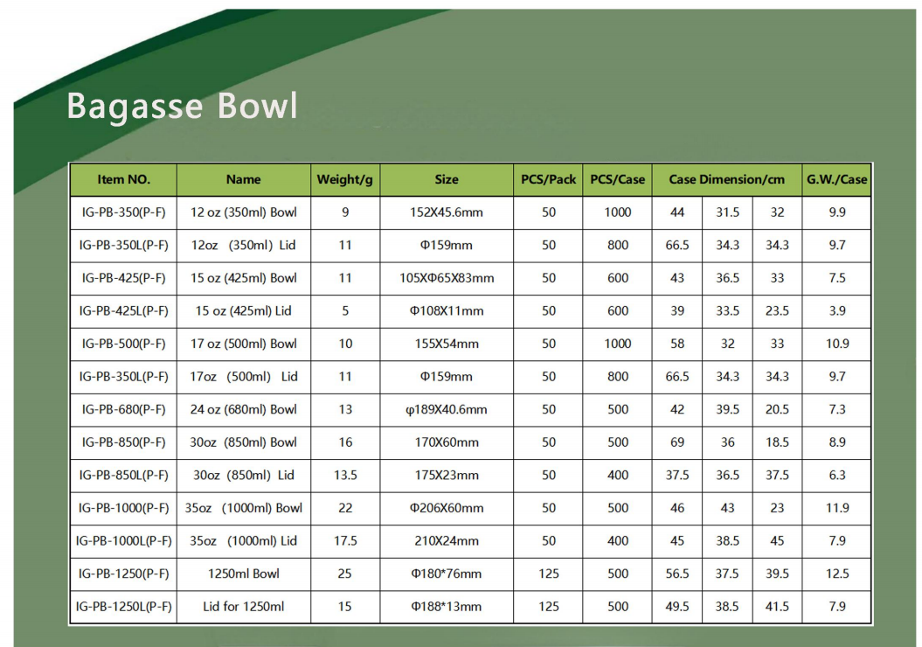
Bagasse Bowl
Item NO. | Name | Weight/g | Size | PCS/Pack | PCS/Case | Case Dimension/cm |  |  | G.W./Case
IG-PB-350(P-F) | 12 oz(350ml)Bowl | 9 | 152X45.6mm | 50 | 1000 | 44 | 31.5 | 32 | 9.9
IG-PB-350L(P-F) | 12oz(350ml)Lid | 11 | φ159mm | 50 | 800 | 66.5 | 34.3 | 34.3 | 9.7
IG-PB-425(P-F) | 15oz(425ml)Bowl | 11 | 105X65X83mm | 50 | 600 | 43 | 36.5 | 33 | 7.5
IG-PB-425L(P-F) | 15 oz(425ml)Lid | 5 | φ108X11mm | 50 | 600 | 39 | 33.5 | 23.5 | 3.9
IG-PB-500(P-F) | 17 oz(500ml)Bowl | 10 | 155X54mm | 50 | 1000 | 58 | 32 | 33 | 10.9
IG-PB-350L(P-F) | 17oz(500ml)Lid | 11 | ①159mm | 50 | 800 | 66.5 | 34.3 | 34.3 | 9.7
IG-PB-680(P-F) | 24oz(680ml)Bowl | 13 | φ189X40.6mm | 50 | 500 | 42 | 39.5 | 20.5 | 7.3
IG-PB-850(P-F) | 30oz(850ml)Bowl | 16 | 170X60mm | 50 | 500 | 69 | 36 | 18.5 | 8.9
IG-PB-850L(P-F) | 30oz(850ml)Lid | 13.5 | 175X23mm | 50 | 400 | 37.5 | 36.5 | 37.5 | 6.3
IG-PB-1000(P-F) | 35oz(1000ml)Bowl | 22 | φ206X60mm | 50 | 500 | 46 | 43 | 23 | 11.9
IG-PB-1000L(P-F) | 35oz(1000ml)Lid | 17.5 | 210X24mm | 50 | 400 | 45 | 38.5 | 45 | 7.9
IG-PB-1250(P-F) | 1250ml Bowl | 25 | φ180*76mm | 125 | 500 | 56.5 | 37.5 | 39.5 | 12.5
IG-PB-1250L(P-F) | Lid for 1250ml | 15 | φ188*13mm | 125 | 500 | 49.5 | 38.5 | 41.5 | 7.9

Slide 11

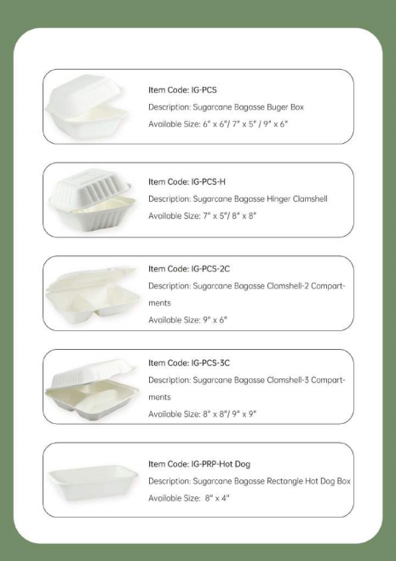
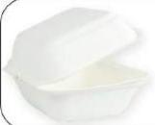
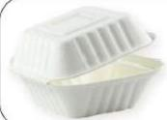
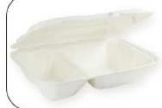
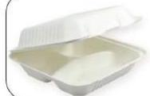
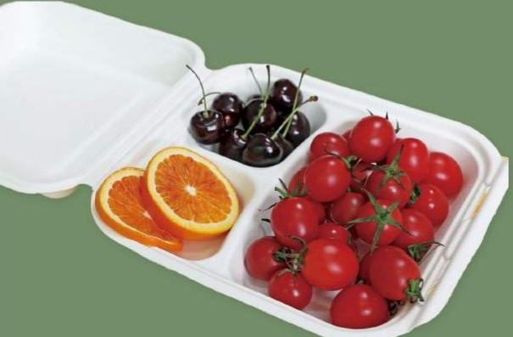

Item Code:IG-PCS
Description:Sugarcane Bagasse Buger Box
Available Size:6"x6"/7"×5"/9"x6"
Item Code:IG-PCS-H
Description:Sugarcane Bagasse Hinger Clamshell Available Size:7"×5"/8"×8"
Item Code:IG-PCS-2C
Description:Sugarcane Bagasse Clamshell-2 Compart-
ments
Available Size:9"×6"
CLAMSHELL
·Materical:Made from 100%renewable resources.
·Packing:50PCS/PACK;500PCS/CTN.
·Meet ASTM standards for compostability.
·These fiber clamshells are great for cold or hot food. Great for take out restaurants,cafes and food trucks.
·Our clamshells are available in various sizes to suit both retail and takeaway applications.
Item Code:IG-PCS-3C
Description:Sugarcane Bagasse Clamshell-3 Compart- ments
Available Size:8"x8"/9"×9"
Item Code:IG-PRP-Hot Dog
Description:Sugarcane Bagasse Rectangle Hot Dog Box Available Size:8"×4"

Slide 12
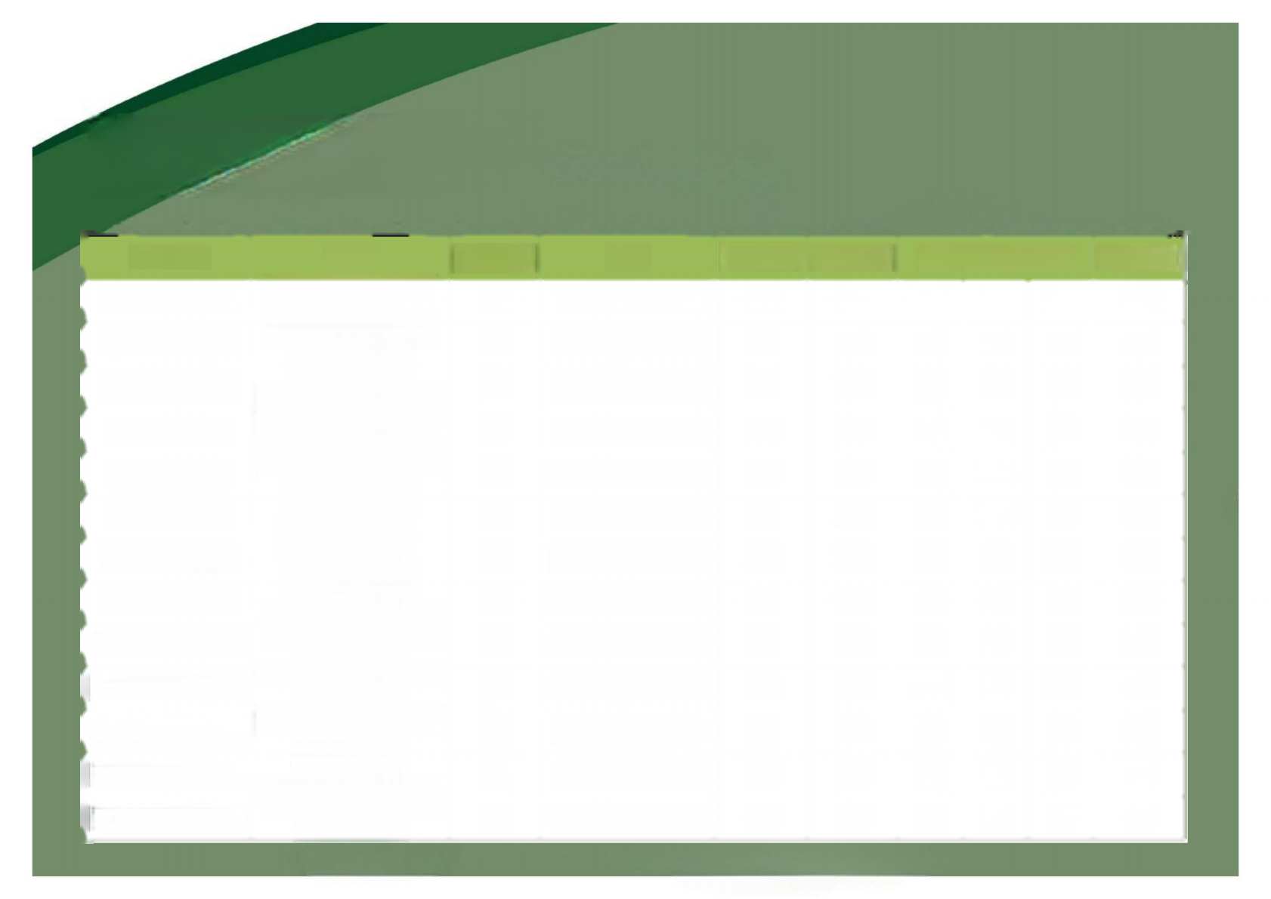
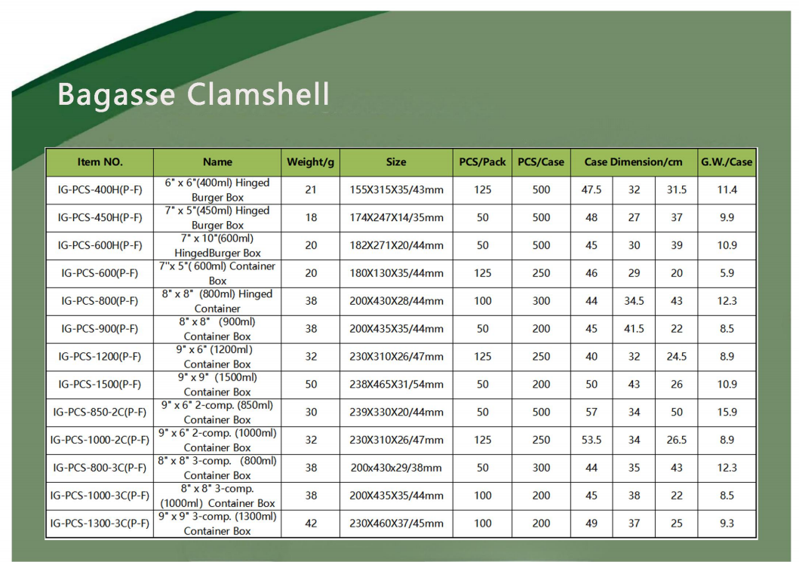
Bagasse Clamshell
Item NO. | Name | Weight/g | Size | PCS/Pack | PCS/Case | Case Dimension/cm |  |  | G.W./Case
IG-PCS-400H(P-F) | 6°×6”(400ml)Hinged | 21 | 155X315X35/43mm | 125 | 500 | 47.5 | 32 | 31.5 | 11.4
IG-PCS-450H(P-F) | 7“x5450mD Hinged | 18 | 174X247X14/35mm | 50 | 500 | 48 | 27 | 37 | 9.9
IG-PCS-600H(P-F) | 7×10600m) | 20 | 182X271X20/44mm | 50 | 500 | 45 | 30 | 39 | 10.9
IG-PCS-600(P-F) | 576o0uorbane | 20 | 180X130X35/44mm | 125 | 250 | 46 | 29 | 20 | 5.9
IG-PCS-800(P-F) | 8*x8 · (80mD Higed | 38 | 200X430X28/44mm | 100 | 300 | 44 | 34.5 | 43 | 12.3
IG-PCS-900(P-F) | 8*x8690om) | 38 | 200X435X35/44mm | 50 | 200 | 45 | 41.5 | 22 | 8.5
IG-PCS-1200(P-F) | 9-xf“i120B) | 32 | 230X310X26/47mm | 125 | 250 | 40 | 32 | 24.5 | 8.9
IG-PCS-1500(P-F) | 9°x9 (150m) | 50 | 238X465X31/54mm | 50 | 200 | 50 | 43 | 26 | 10.9
IG-PCS-850-2C(P-F) | 9°x6°2-conp 850m) Container Box | 30 | 239X330X20/44mm | 50 | 500 | 57 | 34 | 50 | 15.9
IG-PCS-1000-2C(P-F) | 9°×6"2-comp. (1000ml) Container Box | 32 | 230X310X26/47mm | 125 | 250 | 53.5 | 34 | 26.5 | 8.9
IG-PCS-800-3C(P-F) | 8"×8"3-comp. (800ml) Container Box | 38 | 200x430x29/38mm | 50 | 300 | 44 | 35 | 43 | 12.3
IG-PCS-1000-3C(P-F) | 8"×8"3-comp. (1000ml)Container Box | 38 | 200X435X35/44mm | 100 | 200 | 45 | 38 | 22 | 8.5
IG-PCS-1300-3C(P-F) | 9°×9"3-comp. (1300ml) Container Box | 42 | 230X460X37/45mm | 100 | 200 | 49 | 37 | 25 | 9.3

Slide 13

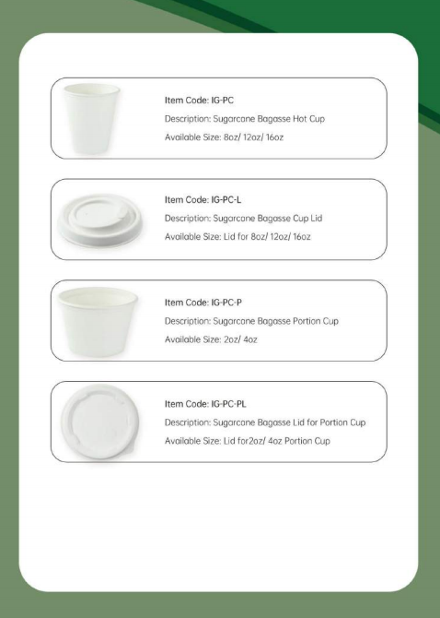
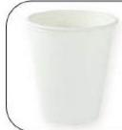

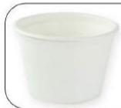

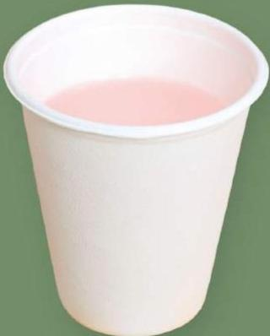
CUP
·Packing:50PCS/PACK;1000PCS/CTN.
·Materical:Made from 100%renewable resources.
·Meet ASTM standards for compostability.
·These disposable hot cups are great for warm beverages like coffee,tea,and hot cocoa.
Item Code:IG-PC
Description:Sugarcane Bagasse Hot Cup
Available Size:8oz/12oz/16oz
Item Code:IG-PC-L
Description:Sugorcane Bagasse Cup Lid
Available Size:Lid for 8oz/12oz/160z
Item Code:IG-PC-P
Description:Sugarcane Bagasse Portion Cup Available Size:2oz/4oz
Item Code:IG-PC-PL
Description:Sugarcone Bagasse Lid for Portion Cup
Available Size:Lid for2oz/4oz Portion Cup

Slide 14

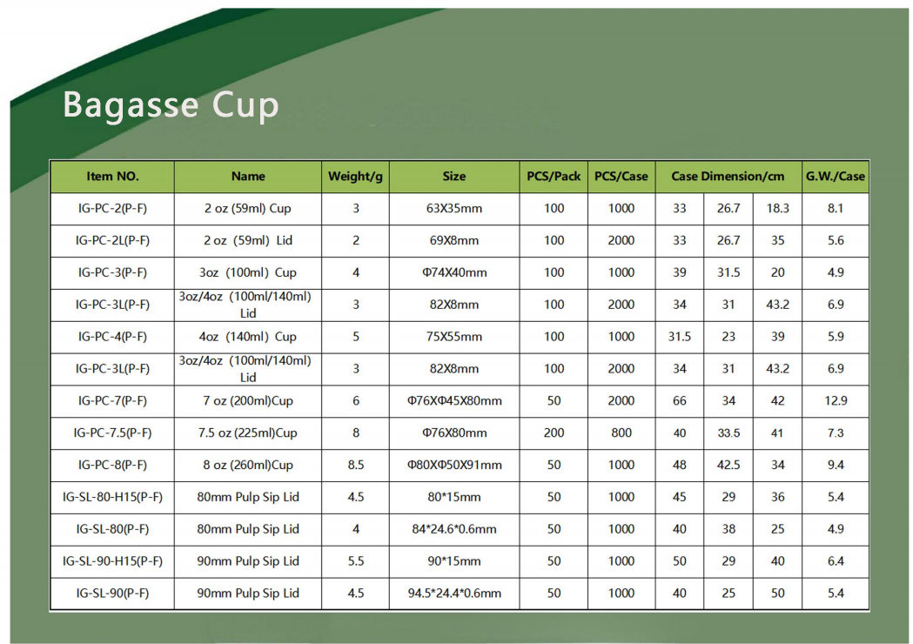
Bagasse Cup
Item NO. | Name | Weight/g | Size | PCS/Pack | PCS/Case | Case Dimension/cm |  |  | G.W./Case
IG-PC-2(P-F) | 2 oz(59ml)Cup | 3 | 63X35mm | 100 | 1000 | 33 | 26.7 | 18.3 | 8.1
IG-PC-2L(P-F) | 2 oz(59ml)Lid | 2 | 69X8mm | 100 | 2000 | 33 | 26.7 | 35 | 5.6
IG-PC-3(P-F) | 3oz(100ml)Cup | 4 | φ74X40mm | 100 | 1000 | 39 | 31.5 | 20 | 4.9
IG-PC-3L(P-F) | 3oz/40z(100ml/140ml) Lid | 3 | 82X8mm | 100 | 2000 | 34 | 31 | 43.2 | 6.9
IG-PC-4(P-F) | 4oz(140ml)Cup | 5 | 75X55mm | 100 | 1000 | 31.5 | 23 | 39 | 5.9
IG-PC-3L(P-F) | 3oz/4oz(100ml/140ml) Lid | 3 | 82X8mm | 100 | 2000 | 34 | 31 | 43.2 | 6.9
IG-PC-7(P-F) | 7 oz(200ml)Cup | 6 | φ76X45X80mm | 50 | 2000 | 66 | 34 | 42 | 12.9
IG-PC-7.5(P-F) | 7.5 oz(225ml)Cup | 8 | φ76X80mm | 200 | 800 | 40 | 33.5 | 41 | 7.3
IG-PC-8(P-F) | 8 oz(260ml)Cup | 8.5 | φ80Xφ50X91mm | 50 | 1000 | 48 | 42.5 | 34 | 9.4
IG-SL-80-H15(P-F) | 80mm Pulp Sip Lid | 4.5 | 80*15mm | 50 | 1000 | 45 | 29 | 36 | 5.4
IG-SL-80(P-F) | 80mm Pulp Sip Lid | 4 | 84*24.6*0.6mm | 50 | 1000 | 40 | 38 | 25 | 4.9
IG-SL-90-H15(P-F) | 90mm Pulp Sip Lid | 5.5 | 90*15mm | 50 | 1000 | 50 | 29 | 40 | 6.4
IG-SL-90(P-F) | 90mm Pulp Sip Lid | 4.5 | 94.5*24.4*0.6mm | 50 | 1000 | 40 | 25 | 50 | 5.4

Slide 15

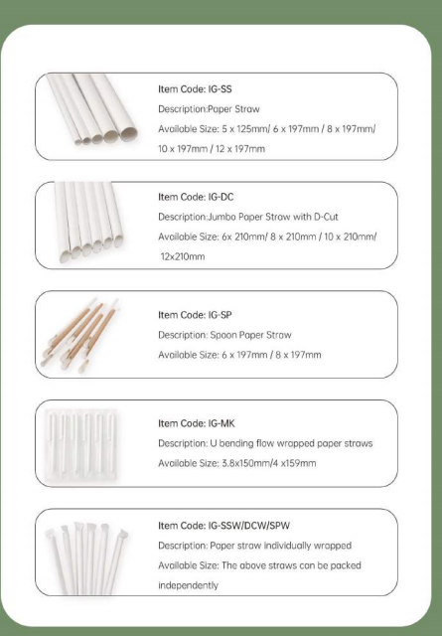
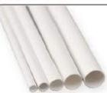
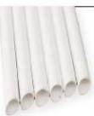
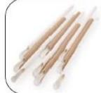
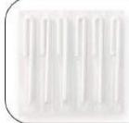

Item Code:IG-SS
Description:Paper Straw
Availoble Size:5×125mm/6×197mm/8×197mm/
10×197mm/12×197mm
Item Code:IG-DC
Description:Jumbo Paper Straw with D-Cut
Available Size:6x210mm/8×210mm/10×210mm/
12×210mm
Item Code:IG-SP
Description:Spoon Paper Straw
Available Size:6×197mm/8×197mm
Item Code:IG-MK
Description:Ubending flow wrapped paper straws Available Size:3.8x150mm/4x159mm
Item Code:IG-SSW/DCW/SPW
Description:Poper straw individually wropped Available Size:The above straws can be packed independently
STRAW
·Packing:100PCS/PACK;10000PCS/CTN.
·iGreen paper straws are made from FSC paper and are FDA/LFGB/EN13432 certified.
·These straws are very strong and long lasting.Great for cold drinks at restaurants,food trucks,personal and family use,party straw and events.
·A variety of length for your choice,customization is avail- able.

Slide 16




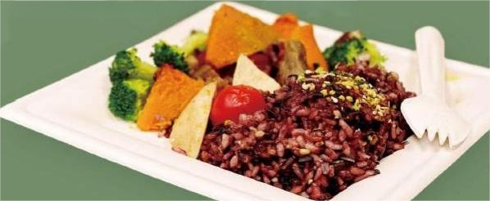
BAGASSE CUTLERY
·Packing:100PCS/PACK.
·iGreen Sporks are made from 100%recycled sugarcane pulp.They are designed to reduce waste and provide a safe,non-toxic alternative to plastic ones.
·These sporks are appropriate for hot or cold food and usually for restaurants cafes and convenience store.
·These cutleries are individually wrapped or kits.Cutlery kits include fork,knife and spoon.
Item Code:IG-PS
Description:Sugarcane Bagasse spoon
Available Size:160mm
Item Code:IG-PK
Description:Sugarcane Bagasse Knife Available Size:157mm
Item Code:IG-PF
Description:Sugarcane Bagasse Fork Available Size:157mm
Item Code:IG-PSP
Description:Sugarcane Bagasse Spork Available Size:140mm

Slide 17

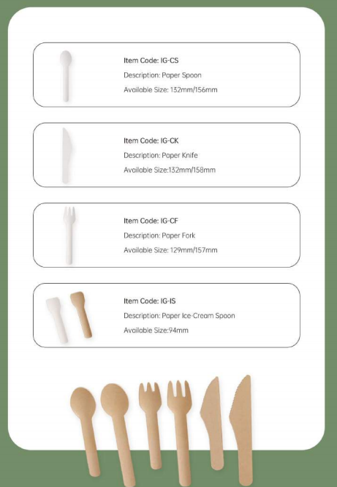



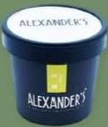
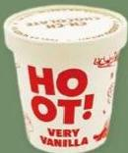

Item Code:IG-CS
Description:Paper Spoon
Available Size:132mm/156mm
Item Code:IG-CK
Description:Paper Knife
Available Size:132mm/158mm
Item Code:IG-CF
Description:Poper Fork
Available Size:129mm/157mm
Item Code:IG-IS
Description:Poper Ice-Cream Spoon Available Size:94mm
PAPER CUTLERY
·Materical:Made from 100%renewable resources.
·Packing:1000PACKS/CTN.
·iGreen paper cutlery is made from FSC paper.They are designed to reduce waste and provide a safe,non-toxic alternative to plastic ones.
·Great for schools,cafes,takeout restaurants or food trucks.

Slide 18





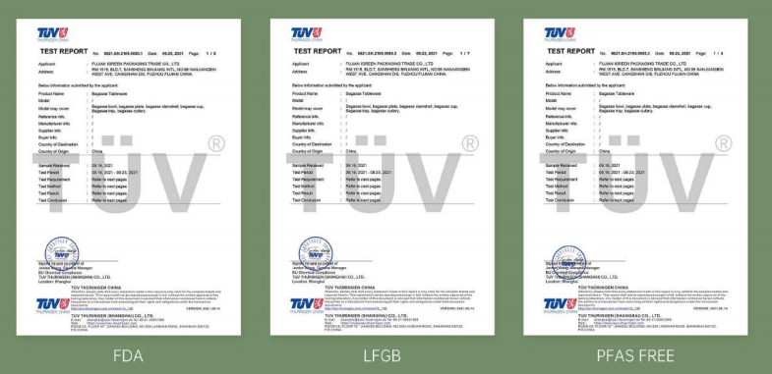






Certification and test report
In order to be responsible for our products and client,every product of SL Global has undergone rigorous testing and
certification.
TUY
TEST REPORT
Appcnt
Addess
TUV TEST REPORT Applaant Aases Beowilonbso submine Proouat Nee Mos6 Mosdmy cew Futureno im Mantchreim Suppiu i. Euypria Coutye Desinaloo Coutyedo Sape Recev四 Test Pes Test Fegarenenu Test Mohod Test Fotut Tenu Conduso 1WTHJFINGENCHNGHAI | 421.5K.2109,80852 Dwe R3 DoPuru byth sppicat Baae TaDewan PNso D9:16,22 D8.16.2021-0923,2021 Rafturt nantpa Ratrto nat pagm Raturt naetpeg0 Atfou to net pojo C₀.LTD.
U
TEST REPORT 421.5H2199.60453 D 9,221 ₁₁₄
Apploart
aeo R1 MDugo
raduat
Modsi
Nan
ray over
Babow nemasnabmiled
Prodact Mane
Nodul
Modil may
Reegnoe r.
Manfacurer nu.
Supsarne
Euyer iws.
Corty tCesinufon
Corty dc
by heplexrt
Bagasse T&are
Qe bes,bo
CHra
Refrans irm,
Manlichearim
sapr no
Buyweie.
Ceustyod Desinator
CeustyeO
snpe facavd
Test Fasod
TestFeqarurent
Test Mabod
Tent Faut
TentCnduo
,bayacr
cisa
Eanpie Raced Test Parod
TestRaqurament Test Mohod
Test Racut
Tou Cnnouo
09.106,2021
09.10,2021-0922.,2021 Reier to nat pages
Rafr io nat pace Fafev to nat poges
Aaor onet oce
918,2021
.0录16,2021-6923.2021 Rabe to nast pam
Raleto nest pam
Ruu to nest sajes
Puy to nest e
:
Mc.G Msoa
BUChand Canclone
Leealont Bhanghu
TOVTHUnIVCEACHN
ema t 注
TUVTHUR₄GEN(SHANGHAJ)co.LTD.
1
coes a asa ne no(aeusROAE aaaz D
Ta GHanco.LTD
Lacdton8gha
Lot 8l
T0v tHORINGENCHINA
e
VEAS0:202t+4
404N299122
+mf
cateL10
TUVTHURINGENGSHANGHAJ)co.LTD.
emsmnaenez ,08
TUVTHURJNGEN(SHANGHAn Go.LTD.
wc :
r 508558
BB NO L⁰ BO
PFAS FREE

Slide 19

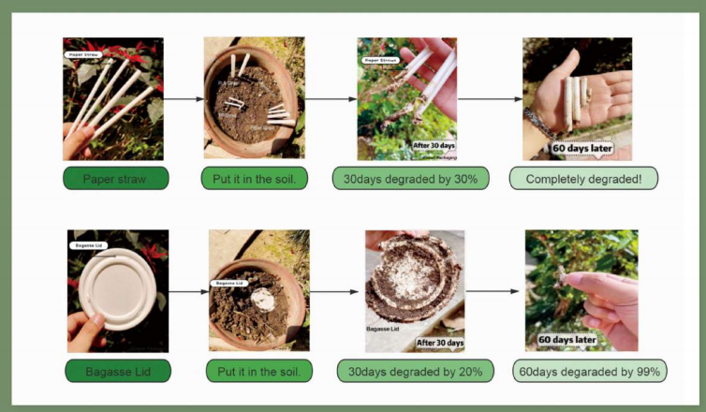
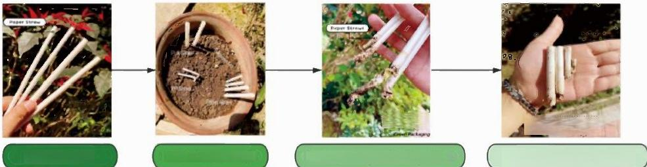
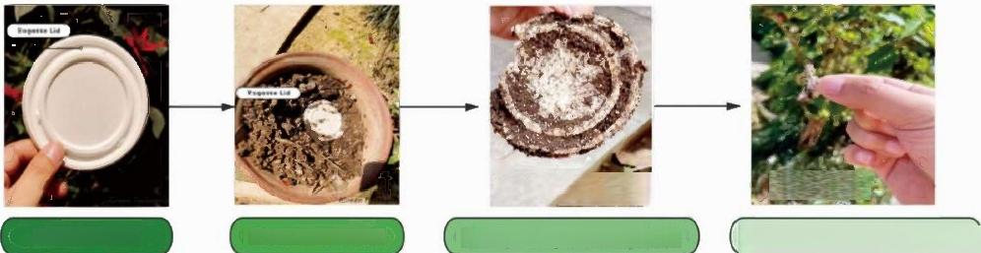
An Experiment of Our Own
It is ful of excitement and curiosity before revealing the experiment result but afterwards,we are quite touched to wit- ness the results.Through the practical experment,it strengthens our faith that the business we are running is super won- derful and meaningful.
Aftor 30 days
30days degraded by 30%
60 days later
Completely degraded!
Paper straw Put it in the soil
BagasseLid
60 dayslater
60days degaraded by 99%
After 30 days
30days degraded by 20%
Bagasse Lid Put it in the soil.

Slide 20

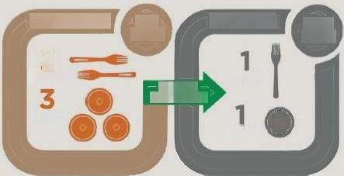
Composting FAQ
Biodegradable or Compostable?
The process is essentially the same,the speed of breakdown is what makes the two terms very different.Compostable means that the product willbreak down in under 12 weeks in an industrial composting facility.Biodegradable,has no set timeline to breakdown.A surf board is biodegradable;thus,the term biodegradable does not have any en- vironmentally positive implications when used to describe to-go pack- aging or utensils.
What's the point if I can't compost it?
Our earth has finite resources.Disposables are used for such a short time,that using renewable resources,such as wheat straw,bagasse, or corn,makes perfect sense.Although some countries don't neces- sarily have the facilities in place to compost,increased compostable product usage,drives the need for change within our waste manage- ment system and allows us to work to build the facilities to support it.
What's the point of disposables being compostable?
Compostable disposables are designed to be mixed with food waste and composted in an industrial facility.This eliminates the need to sort,meaning the lids,cups,utensils,and clamshells with leftover rice and chicken katsu,can all go in the same bin together
What are composting conditions?
Compostable packaging has to be in composting conditions in order to breakdown.Industrial facilities provide the perfect combination of moisture,heat,and microbes to breakdown compostable disposables alongside food waste.
Although compostable disposables may be composted at home (we've seen successful home composting of both Paper straws and Bagasse products).The success of at home composting depends on the skill of the householder to maintain the right temperature,mois- ture,and heat.Based on the experiment of our own,we do guarantee the successful composting of our products at home.
Compostable We Make
Petroleum They Make
2
utensils
plates
utensil
Using the
Same Energy
plate

Slide 21

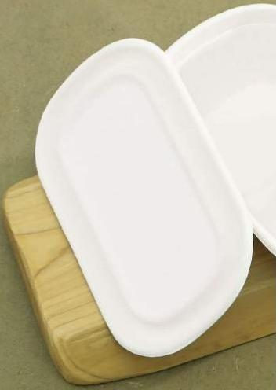
SL Global Partner on
Green Packaging
SL GLOBAL (XIAMEN) IMP&EXP CO.,LTD
Email:SLGLOBALXM@GMAIL.COM
Tel:+61 402 185 450 (AUSTRALIA)
Tel:+86 13960421168 (CHINA)
WEB:SLGLOBAL-6QKLEU.MANUS.SPACE
Add.:Room B121,1st Floor,Yipin Maker SpaceNo.128 Haijing Road,Haicang,Free Trade Zone,Xiamen,Fujian Province,China

